Slide 1
VIDEO CONFERENCING aPPLICATION
Project
Kokane Vishal <13163>
KALE AKSHAY <13181>

Slide 2
INTRODUCTION
Video conferencing is an online technology that allows users in different locations to hold face-to-face meetings without having to move to a single location together. This technology is particularly convenient for business users in different cities or even different countries because it saves time, expenses, and hassles associated with business travel. Uses for video conferencing include holding routine meetings, negotiating business deals, and interviewing job candidates.

Slide 3
Existing SYSTEM
Lack of security of data.
Costly and Slow.
Complex.
Resource Hungry.
Unstable connection.

Slide 4
Proposed system
Minimize travel costs.
Better communication and relationships
Increase productivity.
Telecommuting made easy.
Security of data.
User friendliness and interactive
Better service.
Greater efficiency

Slide 5
Scope of system
Quick actions on any-thing far from distance
Schools and Colleges looking into video conferencing
for student studies.
Smartphones are a game-changer for video conferencing
Focus on Connectivity
Video conferencing being used for counseling.
Upcoming conference takes a look at the future of video conferencing

Slide 6
Objective
Teaching: Video Calling allows easy access to remote expertise. When the number of expertise is small, one lecture can teach various virtual classes at a go thus, travelling to various campuses is significantly reduced.
Meetings: Using Video Calling leads to cost savings on travel, accommodation and staff time. Several sites can be linked together. Having a set time and duration for a meeting encourages punctuality and focused discussion.
Data sharing: Images from a personal computer (PC), such as spreadsheets, PowerPoint illustrations etc. can be shared to enhance a presentation.
Interviews: Cost savings can allow more candidates to be interviewed from remote locations. With data sharing, Video callings can be viewed and discussed online.
Telemedicine: In rural areas, specialist medical help may not be available on hand. By linking to a regional center, cottage hospitals and clinics can receive help in diagnosing patients' disorders.
Legal work: Video Calling helps reduce intimidation of vulnerable court witnesses. Particularly sensitive cases

Slide 7
Requirements
Hardware Requirements:
Processor: Intel/AMD dual-core or above
Processor Speed: 2.0GHZ or above
RAM: 4 GB RAM or above
Disk: 10 GB of SSD/HDD
Operating system: Windows 10
Software Requirements:
Platform: Android studio, Firebase
Technology Used: Java, XML
API keys: Firebase Authentication, Firebase Database, Jit.si meet
Android Device Requirement:
Internet connection
Android 5(Lollipop) or above
RAM: 2GB
Storage: 100MB

Slide 8
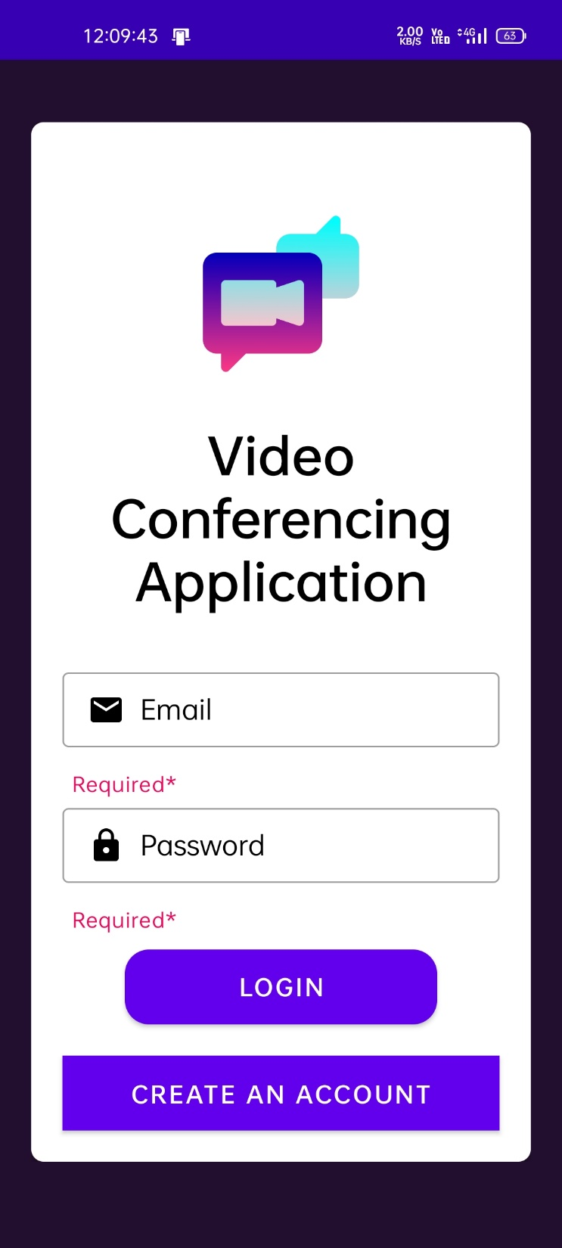
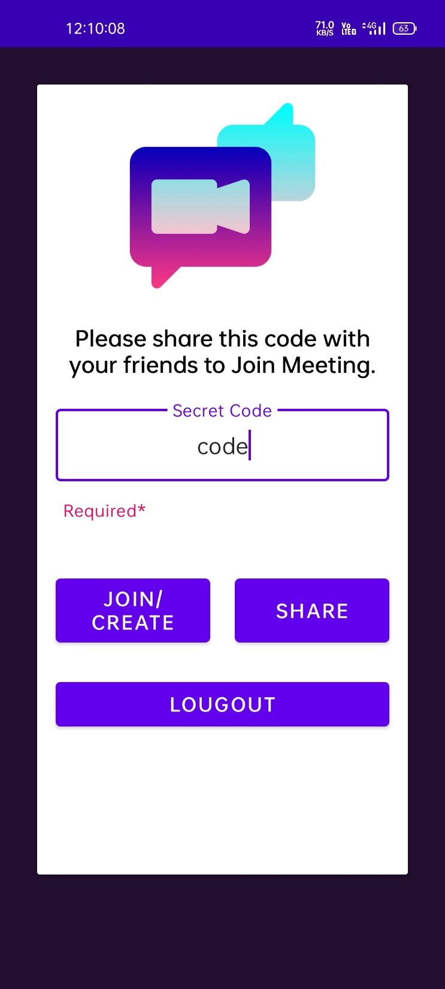
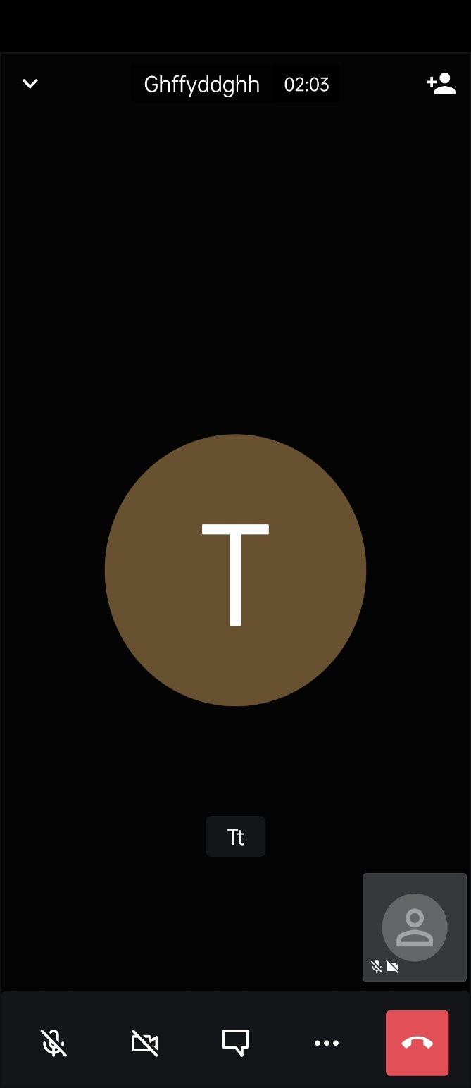
Menu screens

Slide 9
Advantages & limitations
Increases productivity of the employees
Saves time and resources
File and screen-sharing capabilities
Increased savings
Easy to use
Even the best systems can suffer from technical problems
Network connectivity issues
Organizing newly created data
Securing meetings

Slide 10
Future enhancement
Deep integration with other communication solutions (voice, video, SMS) .
The influence of AI.
High-Quality Video and Audio.
Everything is moved to the Cloud.
Video Conferencing Rooms.
More friendly user experience.

Slide 11
.....Thank you.....

